Slide 1
Xerox® D95A/D110/D125 Copier/Printer The power to print more for less, and excite your customers.
Notes:
Welcome! Thank you for joining us today to learn more about the Xerox D95A/D110/D125 Copier/Printer, the printing systems you can rely on to get all your jobs done, from bills to booklets and more.

Slide 2
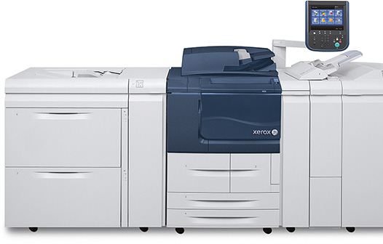
Fast, Flexible and Easy
High print speeds up to 100, 110 and 125 ppm
Outstanding image quality
Flexible workflow
Robust in-line finishing options
Proven reliability

Slide 3
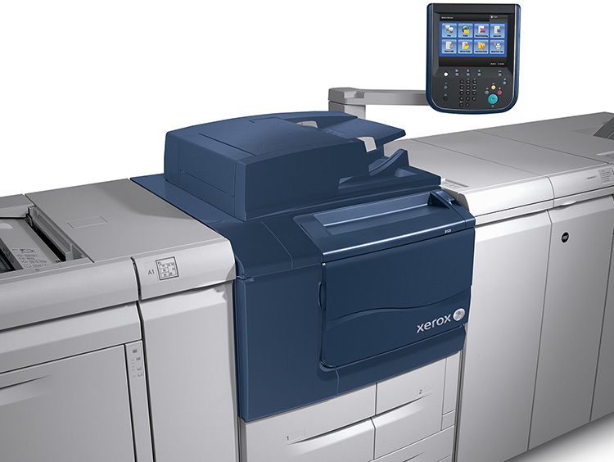
Speed and Efficiency
Fast job completion
Scan at up to 200 ipm
Print at up to 100, 110 or 125 ppm
Large document handler capacity
250 sheet handler
High-quality reproduction
600 x 600 dpi scan resolution
Scan to PDF, JPEG or TIFF
Notes:
This highly efficient copier/printer runs fast so you don’t have to.
The single-pass, dual-head scanner scans at up to 200 images per minute, for both simplex and duplex documents.
As I mentioned, you can choose the print speed that fits your workload and budget requirements with devices that print up to 100, 110 and 125 pages per minute.
The 250-sheet document handler makes large or complex jobs go faster and easier.
Convert hard copy pages to electronic files in TIFF, JPEG or PDF formats and store them in folders for fast reprint as needed.
[NEXT SLIDE]

Slide 4
Speed and Efficiency
Scan features
To email, FTP location or local mailbox
High compression PDF and searchable text
Efficient communications
Optional PDF scan kit
High compression PDF and searchable text PDF
Optional Scan-to / Print-from USB
Notes:
Its scan-to capabilities offer you some great new communication vehicles:
Scan directly to email for inexpensive and immediate communication.
Archive and distribute documents more efficiently with scan to FTP.
Our optional PDF kit offers high-compression and searchable text PDFs.
And our exceptional imaging quality also adds to your application capabilities.
[NEXT SLIDE]

Slide 5
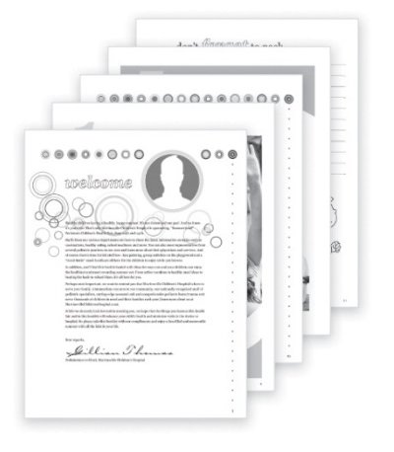
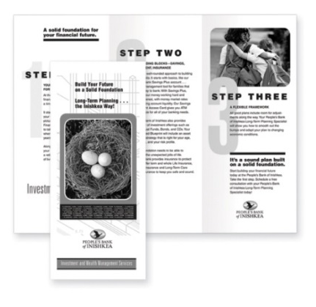
Exceptional Image Quality
It Makes You Look Good
Up to 2400 x 2400 dpi print resolution
Multiple line screen options
Short paper path
Handles paper efficiently
EA Toner
Small uniform particles deliver better IQ
Environmentally friendly
Excellent registration
D95A: +/- 1.8 mm , customer adjustable
D110/D125: +/- 1.0 mm, customer adjustable
Notes:
Our copier/printer delivers up to 2400 x 2400 dpi resolution—multiple-line screen options are available. Its short paper path handles media efficiently.
Innovative EA Toner technology plays a key role in its high imaging quality and offers a number of important benefits.
You’ll achieve finer lines for the highest levels of detailing, sharp text and halftones and deep, solid blacks.
Even the most difficult line work is razor sharp.
Plus:
Higher-rated toner yields let you undertake longer print runs with less operator intervention.
Longer photoconductor life and lower toner requirements per page make our copier/printer more environmentally friendly.
It also provides excellent front to back registration – plus or minus 1.0 mm for the D110/D125 and 1.8 mm for the D95A – which you can adjust.
[NEXT SLIDE]

Slide 6
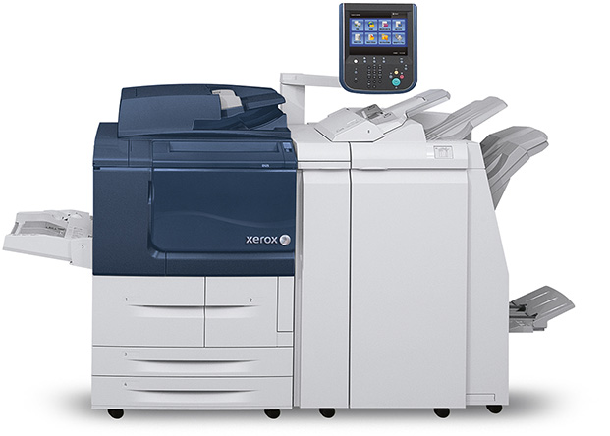
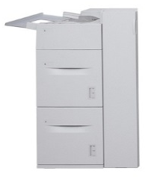
More Capacity, More Productivity
Five standard trays
4,250 sheets standard/custom/oversize
4" x 6" (102 mm x 152 mm) to 13" x 19.2" (333 mm x 488 mm)
16 lb (52 gsm) bond – 140 lb (253 gsm) index
Optional 2-Tray High-Capacity Feeder
Uninterrupted long runs
4,000-sheet capacity
2-Tray High-Capacity Feeder
Notes:
The D95A/D110/D125 Copier/Printer comes with five standard trays that combine to hold 4,250 sheets of standard, custom and oversize media:
Sizes accommodated range from 4” x 6” (102 mm x 152 mm) to 13” x 19.2” (333 mm x 488 mm/A5 to SRA 3).
Weights ranging from 16 lb. bond to 140 lb. index (52 gsm to 253 gsm).
You can also opt for a 2-Tray High-Capacity Feeder or a 1-Tray Oversized High-Capacity Feeder or a 2-Tray Oversized High-Capacity Feeder for:
Enhanced media capacity.
Higher productivity via uninterrupted long runs.
[NEXT SLIDE]

Slide 7
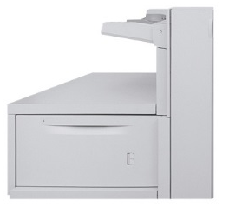
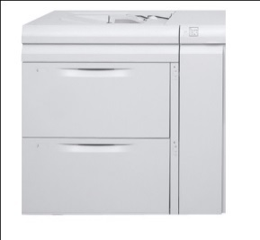
More Capacity, More Productivity (continued)
Optional Oversized High-Capacity Feeder
Approved coated stocks
2,000-sheet capacity
Optional 2-Tray Oversized High-Capacity Feeder (D110/D125 configurations only)
4,000-sheet capacity
Standard Post-process Inserter
Pre-printed offset or digital color
2-Tray Oversized High-Capacity Feeder (D110/D125 only)
Oversized High-Capacity Feeder
Notes:
The High-Capacity Feeder features two trays that each hold 2,000 8.5x11/A4 sheets in 16 lb. bond to 80 lb. cover (52 to 216 gsm).
The Oversized High-Capacity Feeder enables you to use more approved coated stocks. It features one tray that holds 2,000 sheets:
In 8” x 10”/B5 to 13” x 19.2”/SRA3
18 lb. to 110 lb. (62 to 253 gsm)
The 2-Tray Oversized High-Capacity Feeder has the same features as the 1-Tray Oversized High-Capacity Feeder, but it holds 4,000 sheets.
[NEXT SLIDE]

Slide 8
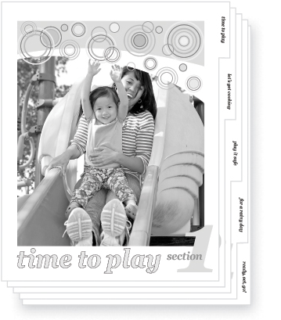
Ready to do more.
Broad range of stocks
Uncoated and coated media
Tab stocks, labels, synthetics
Professional output
Distinctive image quality
Full color covers, color inserts
Security
Large feature set
Encrypt copy/scan/print data
Overwriting to meet corporate standards
Ease of use
Simple for walk-up/experienced users
Notes:
Let’s look at how our copier/printer enables you to DO more.
First, you can add impact to all of your documents by choosing from a broad range of stocks, adding full color covers, using color inserts and more. And our copier/printer’s distinctive image quality ensures that all your output looks professional and polished.
What this really means for you is you can create an expanded suite of applications, right at your point of need.
While you’re doing all this, you can feel confident that your data is protected. Our copier/printer offers a large set of security features including data encryption for your copy, scan and print data. Overwrite capabilities enable you to meet corporate security standards while removable hard drives further augment your data’s safety.
And it is very easy to use—everyone in your environment, from walk-up and casual users to experienced operators, will feel comfortable using our copier/printer thanks to ease-of-use features including:
Straightforward graphical user interface,
Load-while-run, unload-while-run and change-while-run capabilities,
Multiple scan-to destination options,
Engineering Replaceable Units, or ERUs, and
The ability to accept any datastream, any time.
Plus, its small footprint means you can put our copier/printer where it’s most convenient for your users.

Slide 9
Versatile In-line Finishing
Expand Your Applications, Build Your Business
Optional Standard Finisher
Multi-position stapling or dual 100-sheet variable length
2- and 3-hole punching
Stacking and Interposing
Color insertion and tabs
Collating
Bi-fold, C-fold, Z-fold, Eng. Z-fold
Booklet maker finisher with optional C-Z Folder and SquareFold Trimmer Module
Notes:
Our D95A/D110/D125 Copier/Printer’s robust set of in-line finishing options make it ideal for both transactional and publishing environments. It delivers professional output that will save you time and money while growing your business. As I mentioned earlier, you can add color inserts. It also offers:
Variable-length stapling for up to 100 sheets—you’ll get neat output no matter what the size of your document.
Hole-punching will save you time and money—no need to have predrilled paper on hand or to transport for hole punching.
Our optional folder enables you to do bi-folding, C-, Z- and Engineering Z-folding. (That would be tabloid (11” x 17”/A3) folded to fit a letter size (A4) document sets.)
[NEXT SLIDE]
Our booklet finishing options are ideal for large booklets and calendars—up to 25 sheets with 100 imposed pages—100 imaged sides…
The Booklet Maker Finisher
Uses both standard 8.5” x 11”/A4 and 11” x 17”/A3…
As well as special sizes including 8.5” x 14” and 12” x 18”/SRA3,
It provides excellent handling of approved coated stocks, and
Saddle-stitch and bi-fold capabilities.
The SquareFold Trimmer Module further helps you ensure you achieve a professional finish.
For example, it:
Creases cover sheets.
Performs face trimming—you’ll have no paper shingling at the booklet’s fore edge.
And enables you to control trim and the thickness of your square fold—you can create square spine booklets that can be opened flat and are easy to handle, stack and store.

Slide 10
Versatile In-line Finishing (continued)
Optional Booklet Maker Finisher
Up to 25 sheets, 100 imposed pages
Saddle-stitch booklets
Optional Xerox® SquareFold® Trimmer Module
Booklet maker finisher with optional C-Z Folder and SquareFold Trimmer Module
Notes:
Our booklet finishing options are ideal for large booklets and calendars—up to 25 sheets with 100 imposed pages—100 imaged sides…
The Booklet Maker Finisher
Uses both standard 8.5” x 11”/A4 and 11” x 17”/A3…
As well as special sizes including 8.5” x 14” and 12” x 18”/SRA3,
It provides excellent handling of approved coated stocks, and
Saddle-stitch and bi-fold capabilities.
The SquareFold Trimmer Module further helps you ensure you achieve a professional finish.
For example, it:
Creases cover sheets.
Performs face trimming—you’ll have no paper shingling at the booklet’s fore edge.
And enables you to control trim and the thickness of your square fold—you can create square spine booklets that can be opened flat and are easy to handle, stack and store.

Slide 11
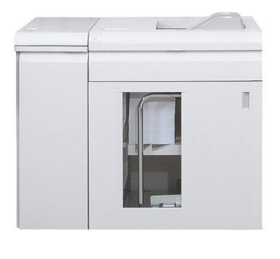
Versatile In-line Finishing (continued)
Optional High Capacity Stacker with rollaway cart
Easy transport and unload
Optional Interface module
Bi-directional decurler
Subset finishing
Program front/back covers
Interface module with High-Capacity Stacker
Notes:
And our optional High Capacity Stacker with rollaway cart:
Stacks up to 5,000 letter-sized sheets.
Has a 500 sheet top tray that handles stock at 64 gsm to 300 gsm and up to 13” x 19.2” (330x488 mm).
It makes it easy for you to transport and unload even your largest jobs.

Slide 12
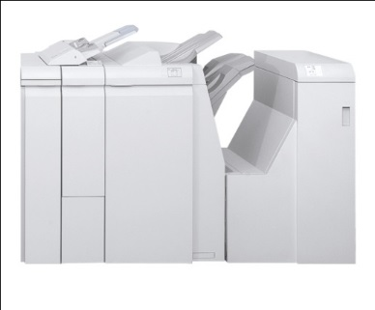
Additional Finishing Options for D110/D125 Configurations
Standard Finisher Plus
Includes Standard Finisher features with optional C/Z Folding plus DFA (Document Finishing Architecture) required to support additional finishing options
GBC® AdvancedPunch™
Several customer replaceable Die Sets available
Standard Finisher Plus
GBC® AdvancedPunch™
Notes:
With the addition of advanced finishing options, the D110/D125 Copier/Printer takes your transactional and publishing capabilities to a higher level of productivity, delivering even more value to your existing customers and providing a key advantage when competing for new business.
Standard Finisher Plus includes all the Standard Finisher features plus Optional C/Z folding and the Document Finishing Architecture required to support additional finishing options for up to 100 sheets—you’ll get neat output no matter what the size of your document.
The GBC AdvancedPunch offers a versatile range of punching styles so you can create documents in-house that are ready for professional binding.
[NEXT SLIDE]

Slide 13
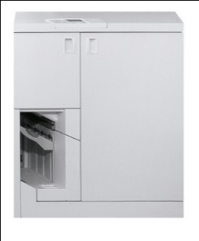
Additional Finishing Options for D110/D125 Configurations (continued)
Xerox® Tape Binder
Binds booklets of up to 125 sheets of 20 lb. (75 gsm) paper
Individual tape refill provides (425) 11 in. binds
Can be combined with the Plockmatic Pro50/35™ Booklet Maker
Xerox® Tape Binder
Notes:
The Xerox Tape Binder binds booklets of up to 125 sheets of 20 lb. (75 gsm) paper. Create professional looking documents that get results: sales proposals, annual reports, course packs or any other materials your business or organization publishes.
[NEXT SLIDE]

Slide 14
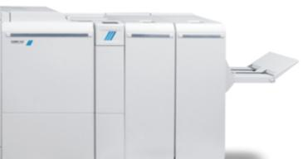
Additional Finishing Options for D110/D125 Configurations (continued)
Plockmatic Pro50/35™ Booklet Maker
Several options available including Xerox® SquareFold®, Cover Feeder, Face Trimmer and Bleed Trim unit
Can be combined with the Xerox® Tape Binder
PlockMatic Pro50/35™ Booklet Maker
Notes:
The Plockmatic Pro50/35 Booklet Maker lets you fold a single sheet, or saddle stitch and fold up to 35 or 50 sheets, producing up to a 140- or 200-page (20 lb. bond / 75 gsm) booklet. You can also expand your booklet-making capabilities by adding the SquareFold® Trimmer and Cover Feeder.

Slide 15
Diverse Applications and Environments
Quick, franchise or enterprise/in-plant printers
Sophisticated jobs, manuals, calendars, catalogs
High quality output, fast turnarounds
Legal, insurance and healthcare
Evidentiary/discovery/ case management documents
Built-in Bates Stamping, reduce-to-fit, in-line punch, high productivity
Education
Curriculum materials, workbooks
Stapled or punched, collated or uncollated sets with slip sheets, lay-flat binding, fast copying and broad media capacity
Service bureau or data center
Statements, bills, schedules
Data stream support, high reliability
Office workgroup
Newsletters, presentations
Ease of use, on-the-fly changes, data security
Notes:
With these versatile in-line finishing options, our copier/printer enables you to create today’s in-demand applications. At the same time, you can also develop innovative, business-generating applications for the future. You can easily produce the applications most desired in key business environments, as you’ll see here. We’ve named a few of the important ways our copier/printer meets the specific needs of customers in these environments—there are, of course, many others as well.
Quick, Franchise or Enterprise/In-plant Printers
Key applications: sophisticated jobs, manuals, collaterals, calendars, catalogs, newsletters and forms
Benefits: High quality output, fast turnarounds
Legal, Insurance and Healthcare
Key applications: discovery and case management documents, schedules, newsletters
Benefits: Built-In Bates Stamping, Reduce-to-Fit feature for edge-to-edge copying, flexible in-line punch style makes it easy to create professionally bound documents in-house, high speed enables high productivity
Education
Key applications: teacher curriculum materials, workbooks, student directories, coursepacks, yearbooks
Benefits: Multiple stapled or punched collated or uncollated sets with slip sheets, lay-flat binding provides 360-degree rotation for easy-to-use documents, fast copying plus broad media capacity gives teachers and assistants more time in the classroom
Service Bureau or Data Center Key applications: statements, bills, schedules
Benefits: Publishing and personalized data stream printing support (with optional FreeFlow Print Server), high reliability ensures you meet tight deadlines
Office Workgroup
Key applications: newsletters, handouts, presentations, reports, correspondence
Benefits: easy to use for everyone, GBC AdvancedPunch enables on-the-fly changes so you can produce ready-to-find presentations and reports, security features protect data
(Note to presenter: See brochure for more details relative to the above environments…)

Slide 16
Choose the Server that Serves You Best
Integrated Copy/Print Server
Productivity delivered through ease-of-use
Built-in server saves money, time, space
Xerox® FreeFlow® Print Server
Unmatched power and synergy across Xerox product portfolio
Superior features to streamline workflow
Notes:
As I mentioned earlier, you can choose from three exceptional servers for our D95A/D110/D125 Copier/Printer:
The Integrated Copy/Print Server offers you tremendous ease-of-use so you can be more productive. And because it’s built in, it saves you space as well as time and money.
Our FreeFlow Print Server gives you great power and synergy all across your fleet of Xerox monochrome, color and highlight color products. It offers a superior feature set and is your choice for production-level printing. And the monitor, keyboard and mouse are all standard.
We’ll look at each of these in greater detail in a moment.

Slide 17
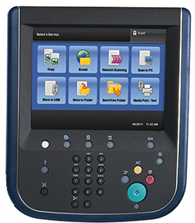
Integrated Copy/Print Server
Simple Workflow
Intuitive GUI and print drivers
Copy/save, print/delete modes
Thumbnail and preview
Xerox® Extensible Interface Platform® (EIP)
Customize to suit your business needs
Exception page programming
Easy programming right at PC or MAC® print driver
Bypass tray programming pop-up at GUI
Notes:
The Integrated Copy/Print Server offers a simple workflow and an easy-to-use touch screen with an intuitive graphic user interface, all in a small footprint.
Graphical drivers let you easily:
Program booklets and do C-folds.
Insert color covers.
This print/server also offers many excellent features to make the flow of your work easier and more productive every day. Let’s look at some of them:
Copy and Save Mode
saves you time and supports a productive reprint workflow
you can respond to your customers faster and complete jobs more efficiently
you simply select it on the touch screen and the copier/printer will save the document you are copying to disk
your document’s images and settings are saved to a mailbox on the integrated copy/print server so they are right there when you want to reprint
your service technician can also back up these saved files before software upgrades and retrieve afterward for added data security during periodic upgrades
Print and Delete Mode is a one-step print and delete option for your mailbox printing.
Thumbnail and Preview enable you to check your job at the touch screen before printing, ensuring convenient job management. You can verify your document's content and be sure appropriate settings are in place before processing. You can merge jobs and delete unwanted pages on the spot. Thumbnail shows the job in a pre-RIP format while Preview shows the post-RIP layout in which the job will print.
Extensible Interface Platform, or EIP, gives you access to third-party applications and external web sites right at our copier/printer’s user interface. Your developers can quickly build and access applications that can be customized for the user interface to meet your requirements. And your operators can quickly access information on the web such as daily business news or new product information right from the printer control panel, without a computer.
Exception Page Programming gives you more flexibility to program your jobs at your PC or MAC Print Driver. You can implement settings for complex jobs, such as color covers, inserts, tabs and Z-folds, right there at your driver or at the integrated copy/print server.
When stock is loaded in the bypass tray, a popup window is triggered on the touch screen. This gives your operators the opportunity to quickly program the bypass tray, just as you would have with trays 1–4.

Slide 18
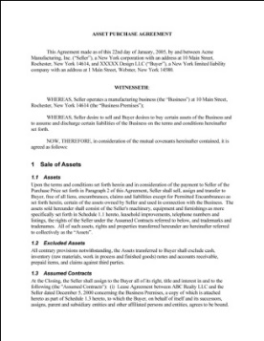
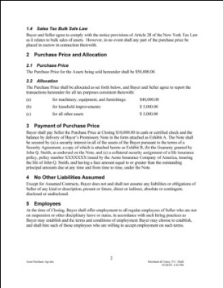
Integrated Copy/Print Server (continued)
Simple Workflow
Key Features
Multiple collated or uncollated sets with slip sheets for education
Built-in Bates Stamping for legal
Alpha-numeric annotations with incremental page numbers
IPv6 compliant
Support for emerging network protocol
Security kit
Data encryption/overwrite/ removable hard drive
Notes:
Our integrated copy/print server offers many other exceptional features as well, for example:
You can easily copy originals and make multiple collated or uncollated sets separated by slip sheets for efficient distribution, stapled or punched, ideal for educational environments.
Built-in Bates Stamping is ideal for legal applications—it generates copies with customized alphanumeric descriptors on each page.
We strive to enable the latest network and security standards like IPv6.
And our optional security kit includes data encryption/overwrite capabilities as well as removable hard drives.

Slide 19
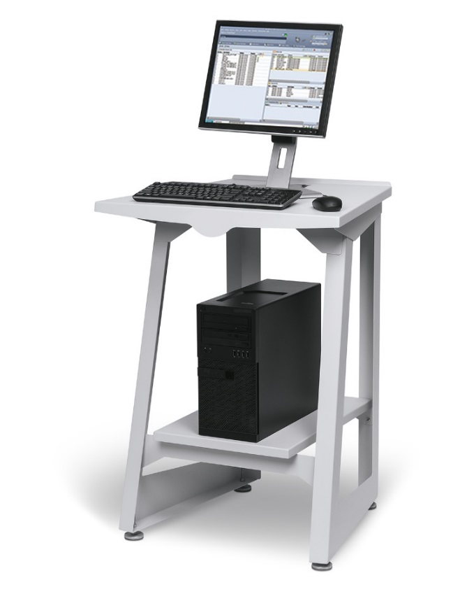
Optional Xerox® Freeflow® Print Server
Production Level Features and Functionality
Unmatched processing power
Fast turnaround
Receive/RIP/print simultaneously
Familiar interface
Quickly add exception pages
List multiple page ranges
Save time, increase productivity
Production features to streamline workflow
Optimized and automated workflows
Preview, edit, proof, interrupt
Reprint on-demand
Notes:
The optional FreeFlow Print Server enables you to significantly augment your copy/scan capabilities with production level printing features and functionality. It’s an ideal way to maximize efficiency for an excellent return on your investment.
Realize faster turnaround times with the unmatched production power of the FreeFlow Print Server and its ability to spool, RIP and print jobs simultaneously. It can quickly handle several jobs at once or one long streaming job for the most efficient workflow. It is ideally suited for transactional printing jobs.
The familiar graphical user interface, or GUI, is easy to use — and now it’s customizable to your needs. It’s the same interface used in Xerox monochrome, color and highlight color devices, so it minimizes your operators’ training and learning curves and maximizes operator agility.
You can quickly add exception pages by specifying lists of multiple page ranges for a particular exception—you’ll save time while increasing productivity.
Features like reprint on demand, preview, edit, proof, and interrupt make the difference in print shop productivity.

Slide 20
Optional Xerox® FreeFlow® Print Server
Manage fleet/extensive job control
Queues and hot folders
Automated job ticketing
Customized workflows
Enhanced rendering of photos in halftones
High-end marketing materials
Superior black-and-white imagery
Any data stream, any time
PostScript, PDF, PCL
IPDS/LCDS
FreeFlow® VI Interpreter, PPML, TIFF
Flexible security
Customize to users/groups
STIG compliance for Government customers
IPv6 compliant

Slide 21
Xerox® Paper and Specialty Media
Digitally optimized
Engineered in concert with our copier/printer
Superior productivity, reliability, flexibility
Expanded media latitude/application offerings with approved coated stocks
Full range of weights/sheet sizes
We offer innovative production solutions to ensure a greener today and tomorrow.
For more information, go to www.xerox.com, www.xerox.com/environment or call 1-800-822-2200
Notes:
We want to be sure you have the right substrates to create the high-value applications we’ve been discussing, which is why we offer a full range of digitally optimized papers and specialty media products.
They have been specifically engineered in concert with our copier/printer to provide you with superior productivity, reliability and flexibility.
With one of the optional Oversized High-Capacity Feeders, you can expand your media latitude and application offerings to include a set of approved coated stocks.
And our broad selection of paper and specialty media, in a full range of weights and sheet sizes, gives you the flexibility to create a wide variety of print applications and finished documents.
You can find out more at xerox.com, or call 1-800-822-2200.
It’s also important to note our commitment to, and our leadership in, environmental sustainability. You can learn more about that at xerox.com as well.

Slide 22
All the support you’ll need.
Maximum Uptime/ Fewer Service Calls with Xerox Service
24/7 Support
Welcome Center: 1-800-ASK-XEROX
Online support assistant: www.xerox.com
Productivity Plus Integrated Maintenance Program
Automatic Meter Read (AMR)
Grow Your Business with Xerox® ProfitAccelerator®
ProfitAccelerator®
^{Digital Business Resources}
www.xerox.com/driveprofit
Notes:
Finally, reliability is something you can really count on with our copier/printer. We offer you our proven world-class service and support.
We are available to you 24 hours a day, 7 days a week via the Welcome Center, which you can reach at 1-800-ASK-Xerox.
You can also rely on our Online Support Assistant, which is available at xerox.com.
We’ve made it easy for you to perform routine maintenance and tune-ups yourself and maximize your uptime via the Xerox Productivity Plus Integrated Maintenance Program.
Finally, Automatic Meter Reads (AMR) ensure accurate billing.
We also support you in growing your digital printing business with ProfitAccelerator. ProfitAccelerator comprises over 75 tools, kits, programs and resources that will help you significantly boost your digital print business and your profits. You can also learn more about ProfitAccelerator at xerox.com.

Slide 23
Like you, it does it all.
Exceptional speeds
Outstanding image/output quality
Flexibility – three workflow options
Robust in-line finishing options
Reliability – count on it!
In a size that fits where you need it
Notes:
To wrap up, as we’ve seen, our D95A/D110/D125 Copier/Printer offers you a broad range of benefits that you can use to grow your business, including:
Up to 100, 110 and 125 ppm speeds.
Outstanding productivity and image and output quality.
The flexibility offered by three exceptional workflow options.
The certainty that it will be up and running when you need it.

Slide 25
Notes:
Thank you for joining me today. Does anyone have any questions?

